Slide 1
Column databases
MIS 64082 – Database Management and Database Analytics
Based on: Next Generation Databases: NoSQL, NewSQL, and Big Data by Guy Harrison, Copyright © 2015 by Guy Harrison
Adaptation - Copyright © 2019 by Alan Brandyberry

Slide 2
Row vs Column Processing
OLTP – On-line Transaction Processing.
Each transaction has operations associated with a row or set of rows within the database.
Example: Add data for a new sale. This would create a new row for each order or line-item to be added.
Supports CRUD – Create, Read, Update, Delete
OLAP – On-line Analytical Processing
Most often is aggregating across all rows or across all of a defined set of rows. Tends to be processed in columns rather than rows.
Example: Calculate quarterly sales for the firm and each sales region.
Supports Decision-Oriented data use
Data Warehousing
In the realm of data warehousing and analytic workloads, row-oriented physical organization is not ideal. In a data warehouse you rarely want to process all the columns of a single row, but you often want to process the values of a single column across all rows. Column-oriented databases address this requirement by storing columns physically together on disk.

Slide 3
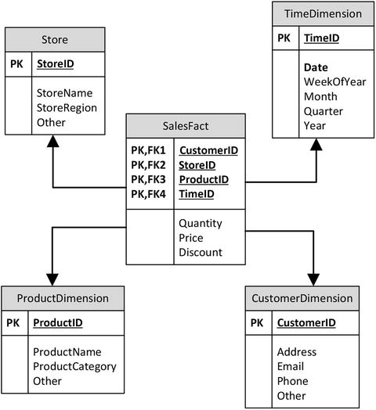
Data Warehouses: Star and Snowflake Schema
Figure 6-1 shows an example of a simplified star schema.
Star schemas were developed to create data warehouses in which aggregate queries could execute quickly and which would provide a predictable schema for Business Intelligence (BI) tools. In a star schema, central large fact tables are associated with numerous smaller dimension tables. When the dimension tables implement a more complex set of foreign key relationships, then the schema is referred to as a snowflake schema.

Slide 4
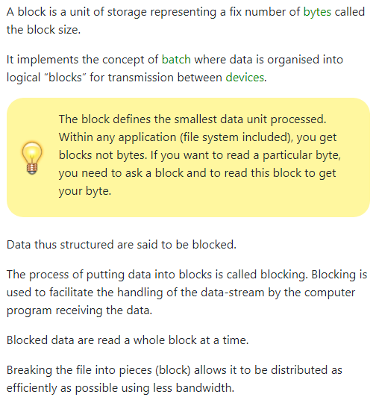
What is a “block”?
The concept of “blocks” give us the primary reason for why columnar databases are more efficient than row-based databases for specific kinds of processing.
It first needs to be understood that no database goes to storage and retrieves a single byte from the disk (or other storage). They retrieve a chunk of physical data from the device that contains the byte. This “block” of data retrieved is then further processed to find the byte (or bytes) of data sought. The rest of the block (after retrieving all bytes of interest) is discarded).
The size of a block can be set by an administrator and there is an optimal block size for every database.
From:
https://gerardnico.com/io/block Retrieved 4/29/2019

Slide 5
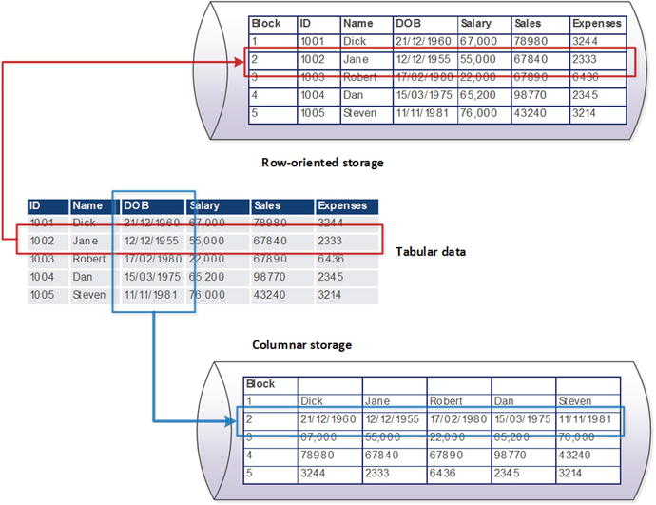
Figure 6-2. Comparison of columnar and row-oriented storage
The essence of the columnar concept is that data for columns is grouped together on disk. Figure 6-2 compares columnar and row-oriented storage for some simple data: in a columnar database, values for a specific column become co-located in the same disk blocks, while in the row-oriented model, all columns for each row are co-located.

Slide 6
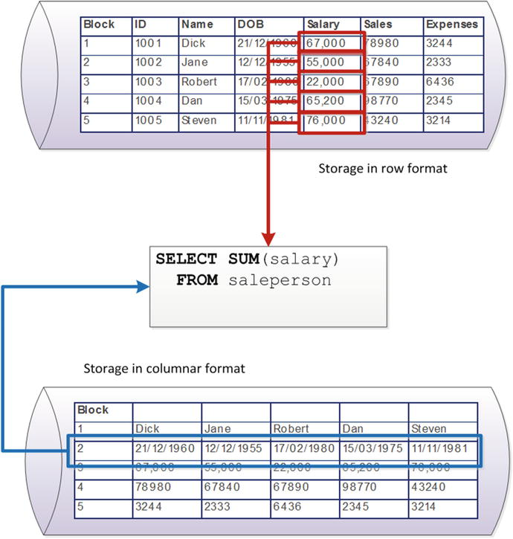
Figure 6-3. Aggregate operations in columnar stores require fewer IOs
There are two big advantages to the columnar architecture. First, in a columnar architecture, queries that seek to aggregate the values of specific columns are optimized, because all of the values to be aggregated exist within the same disk blocks. Figure 6-3 illustrates this phenomenon for our sample database; retrieving the sum of salaries from the row store must scan five blocks, while a single block access suffices in the column store. The second advantage is efficient compression.
Book Error: The highlighted data should have been Block 3 (salaries) rather than Block 2 (DOB) as shown here.

Slide 7
Columnar Database Use cases
Key benefits to column-oriented databases:
High performance on aggregation queries (like COUNT, SUM, AVG, MIN, MAX)
Highly efficient data compression and/or partitioning
True scalability and fast data loading for Big Data
Accessible by many 3rd party BI analytic tools
Fairly simple systems administration
Due to their aggregation capabilities which compute large numbers of similar data items, column-oriented databases offer key advantages for certain types of systems, including:
Data Warehouses and Business Intelligence
Customer Relationship Management (CRM)
Library Card Catalogs
Ad hoc query systems
https://www.dbbest.com/blog/column-oriented-database-technologies/ Retrieved 4/29/2019.

Slide 8
Other Columnar Concepts
Columnar Compression
Another key advantage for the columnar architecture is compression. Compression algorithms work primarily by removing redundancy within data values. Data that is highly repetitious—especially if those repetitions are localized—achieve higher compression ratios than data with low repetition.
Data is much more repetitious in columns. Increases compression efficiency and effectiveness.
Columnar Write Penalty
The key disadvantage of the columnar architecture—and the reason it is a poor choice for OLTP databases—is the overhead it imposes on single row operations.
Inserting a new instance still requires creating a “row” of data. Since each column may be in a different block, this can be very inefficient in a columnar database.
Columnar History
In the mid-1990s, Sybase—one of the top four relational database vendors of the day— acquired Expressway. Expressway had developed what was arguably the first significant commercial column-oriented database. Expressway technology became the basis of Sybase IQ (“Intelligent Query”), which became Sybase’s flagship data warehousing platform.
In 2005, relational pioneer and Ingres inventor Mike Stonebraker and colleagues published a paper outlining a formal database system that they called C-store. C-store shared many characteristics with existing columnar systems

Slide 9
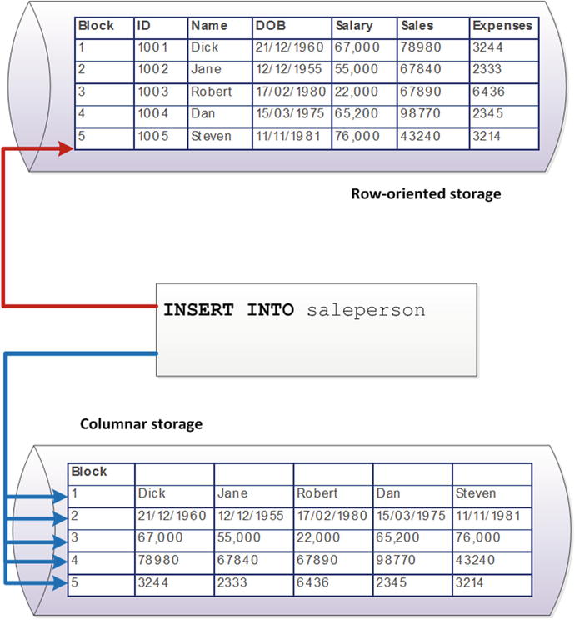
Figure 6-4. Insert overhead for a column store
Figure 6-4 illustrates the insert overhead for a column store on our simple example database. The row store need only perform a single IO to insert a new value, while the column store must update as many disk blocks as there are columns.

Slide 10
Column Database Architectures
Write-optimized delta store (delta store for short)
It became increasingly important for data warehouses to provide real-time “up-to-the-minute” information, which implied that the data warehouse should be able to accept a constant trickle feed of changes.
The delta store is generally memory resident, the data is generally uncompressed, and the store can accept high-frequency data modifications.
Data in the delta store is periodically merged with the main columnar-oriented store. The merge will occur periodically, or whenever the amount of data in the delta store exceeds a threshold. Prior to the merge, queries might have needed to access both the delta store and the column store in order to return complete and accurate results.
Large-scale bulk sequential loads—such as nightly ETL jobs—will generally be directed to the column store (1). Incremental inserts and updates will be directed to the write-optimized store (2). Queries may need to read from both stores in order to get complete and consistent results (3). Periodically, or as required, a process will shift data from the write-optimized store to the column store (4).
Projections
columnar databases such as Vertica store tables physically as a series of projections, which contain combinations of columns that are frequently accessed together. This makes queries containing multiple columns more efficient when the columns are in the same projection.

Slide 11
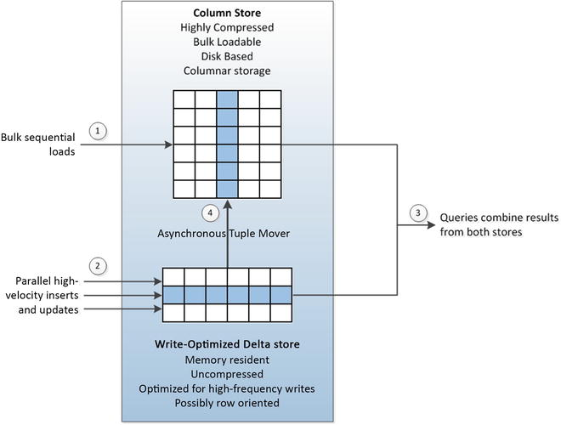
Figure 6-5. Write optimization in column store databases
Figure 6-5 shows a generic columnar database architecture. The database contains a primary column store that contains highly compressed columnar data backed by disk storage. A smaller write-optimized delta store contains data that is minimally compressed, memory resident, and possibly row oriented.

Slide 12
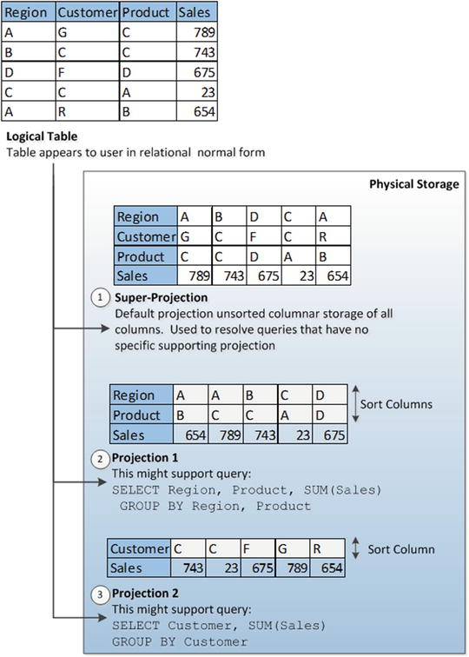
Figure 6-6. Columnar database table with three projections
In Figure 6-6 we see a single logical table with three projections. For example, in Vertica¹, each table has a default superprojection that includes all the columns in the table (1). Additional projections are created to support specific queries. In this case, a projection is created to support sales aggregated by customer (2) and another projection created for sales aggregated by region and product (3).
¹Vertica is a NewSQL database product. It is a column-oriented relational database.

